Slide 1

Efficient Booth Multiplier for FIR Filter Structure
Jeet Gandhi¹, Deepak Nair¹, Nehal Shah¹, Niket Singla²
¹Department of Electronics & Communication Engineering, Sarvajanik College of Engineering and Technology, Surat, India
²Project Associate, C2S Project, Sardar Vallabhbhai National Institute of Technology, Surat

Slide 2
Agenda
Introduction
Motivation
Multiplier
Adder
FIR Filter
Result and Discussion
Conclusion

Slide 3
Introduction
Booth Multiplier is a circuit which is integrated with Adder and Delay Element to form a filter to remove unwanted components or features from a signal.
In the implementation of digital filters, multiplication and addition plays a vital role.
Both are used in all signal processing applications such as convolution, filtering, digital transformation etc.
In some applications, higher levels of accuracy can be managed with an optimized result of digital filter output.

Slide 4
Motivation
VLSI IC design focuses on optimizing power, performance, and area (PPA).
Low-power, small-area circuits are essential for handheld, wearable, IoT, biomedical, industrial, and consumer devices.
TWS chips (used in AirPods /earbuds) integrate Bluetooth RF transceivers with complex filters like FIR, LMS, and ANC.
These functions require highly efficient computation blocks such as optimized multipliers and adders.

Slide 5
Fundamentals of Booth’s Algorithm
Efficient for signed number multiplication in two’s complement form.
Reduces partial products when the multiplier has consecutive 1s or 0s fewer additions.
Key Components:
  Shift Registers – Store multiplier and accumulated result.
  Adders/Subtractors – Perform addition or subtraction of multiplicand based on bit-pair analysis.
  Control Logic – Decides when to add, subtract, or skip, using multiplier bits.
  Sign Extension – Ensures correct handling of negative numbers.

Slide 6
Booth Multiplier
Scheme | Group Width | Bit Selecting Pattern | Encoding bits | Partial Products, N= multiplier bits | Operations
Radix-4 | 3 bits |  | [000, 001, … 110, 111] = 8 | N / 2 | 0, ±A, ±2A
Radix-8 | 4 bits |  | [0000, 0001, …, 1110, 1111] = 16 | N / 3 | 0, ±A, ±2A, ±3A, ±4A
Radix-16 | 5 bits |  | [00000, 00001, …, 11110, 11111] = 32 | N / 4 | 0 to ±8A
A₇ A₆ A₅ A₄ A₃ A₂ A₁ A₀ 0
A₈ A₇ A₆ A₅ A₄ A₃ A₂ A₁ A₀ 0
A₇ A₆ A₅ A₄ A₃ A₂ A₁ A₀ 0

Slide 7
Comparison of Multiplier [4], [5], [6]
Radix | Core Idea | Sizes | Key Opt. | Gains
4^{[4]} | Inverter-based 2’s comp, redundant logic removal, signed compressors, opt. CLA | 8-bit | Min. path delay PP gen, 2-XOR compressors, 13-bit CLA cascade | Delay↓, area↓, power↓,
8^{[5]} | Precompute NT multiples (3×,5×,7×), 3-bit grouping, BEC-like PP reduce | 8–64-bit | PP count↓ (~N/3), light BEC units | area↓, power↓
16^{[6]} | Smaller mux in PP gen (32→9→8), pipelined PP add | 16, 32-bit | Mod. Booth encoding, zero-bit skip, 2–3 stage pipeline | Delay↓, power↓, FPGA use↓

Slide 8
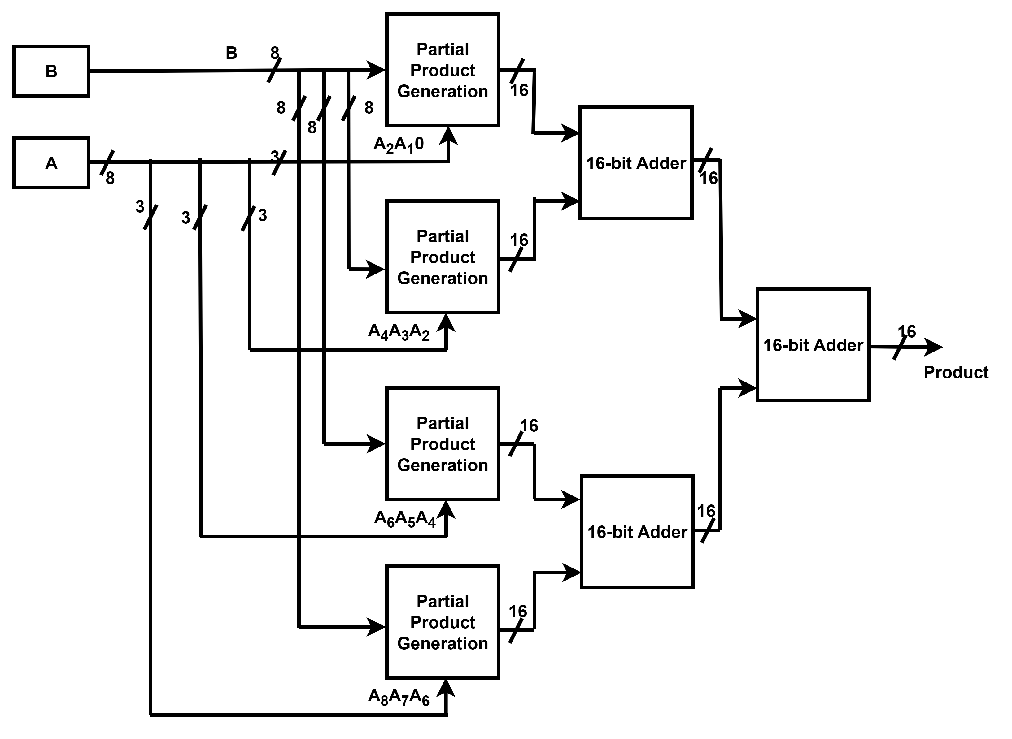
Conventional Booth Multiplier
Partial product generation includes to generate partial product based on the booth encoding bits with multiplexer
Booth encoding bits
16-bit RTL Adder
Shifting operation

Slide 9
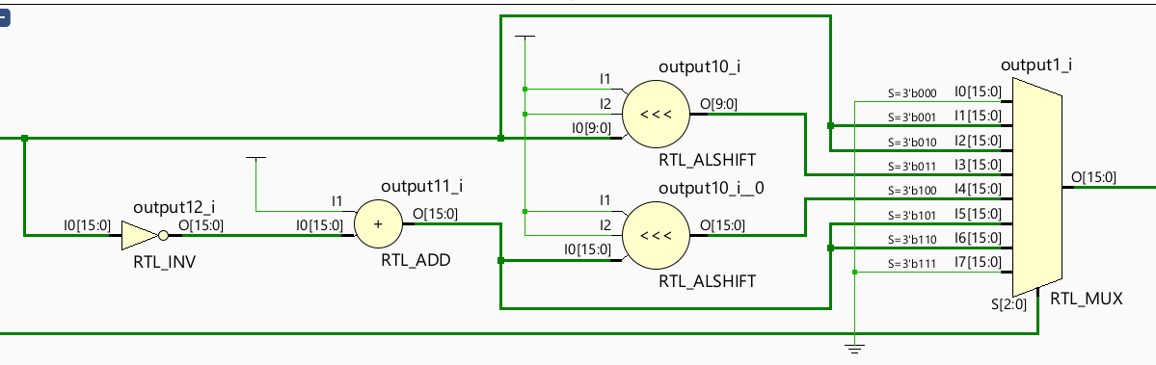
Partial product generation
Binary to 2's Complement to create –Ve value
Shifting operation
Partial product selection through mux

Slide 10
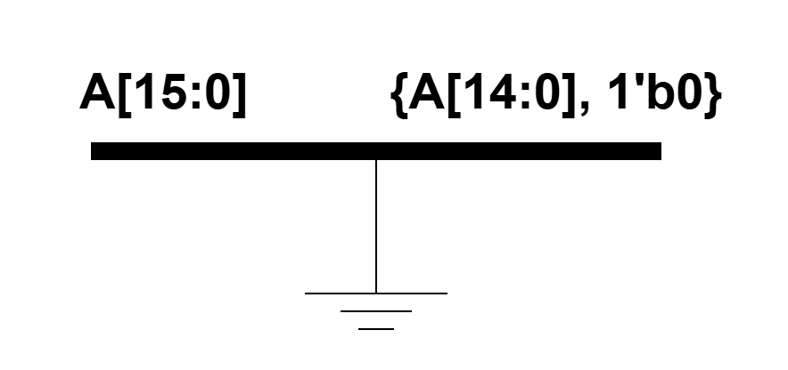
Why Bit Append Compared to Shift operation
<<<
a
shifted
RTL shift operator Increases hardware activity, uses barrel shifter or shift logic, adds delay to execute.
Bit append adds a fixed 0 to the LSB without shift logic, eliminating extra logic and delay.

Slide 11
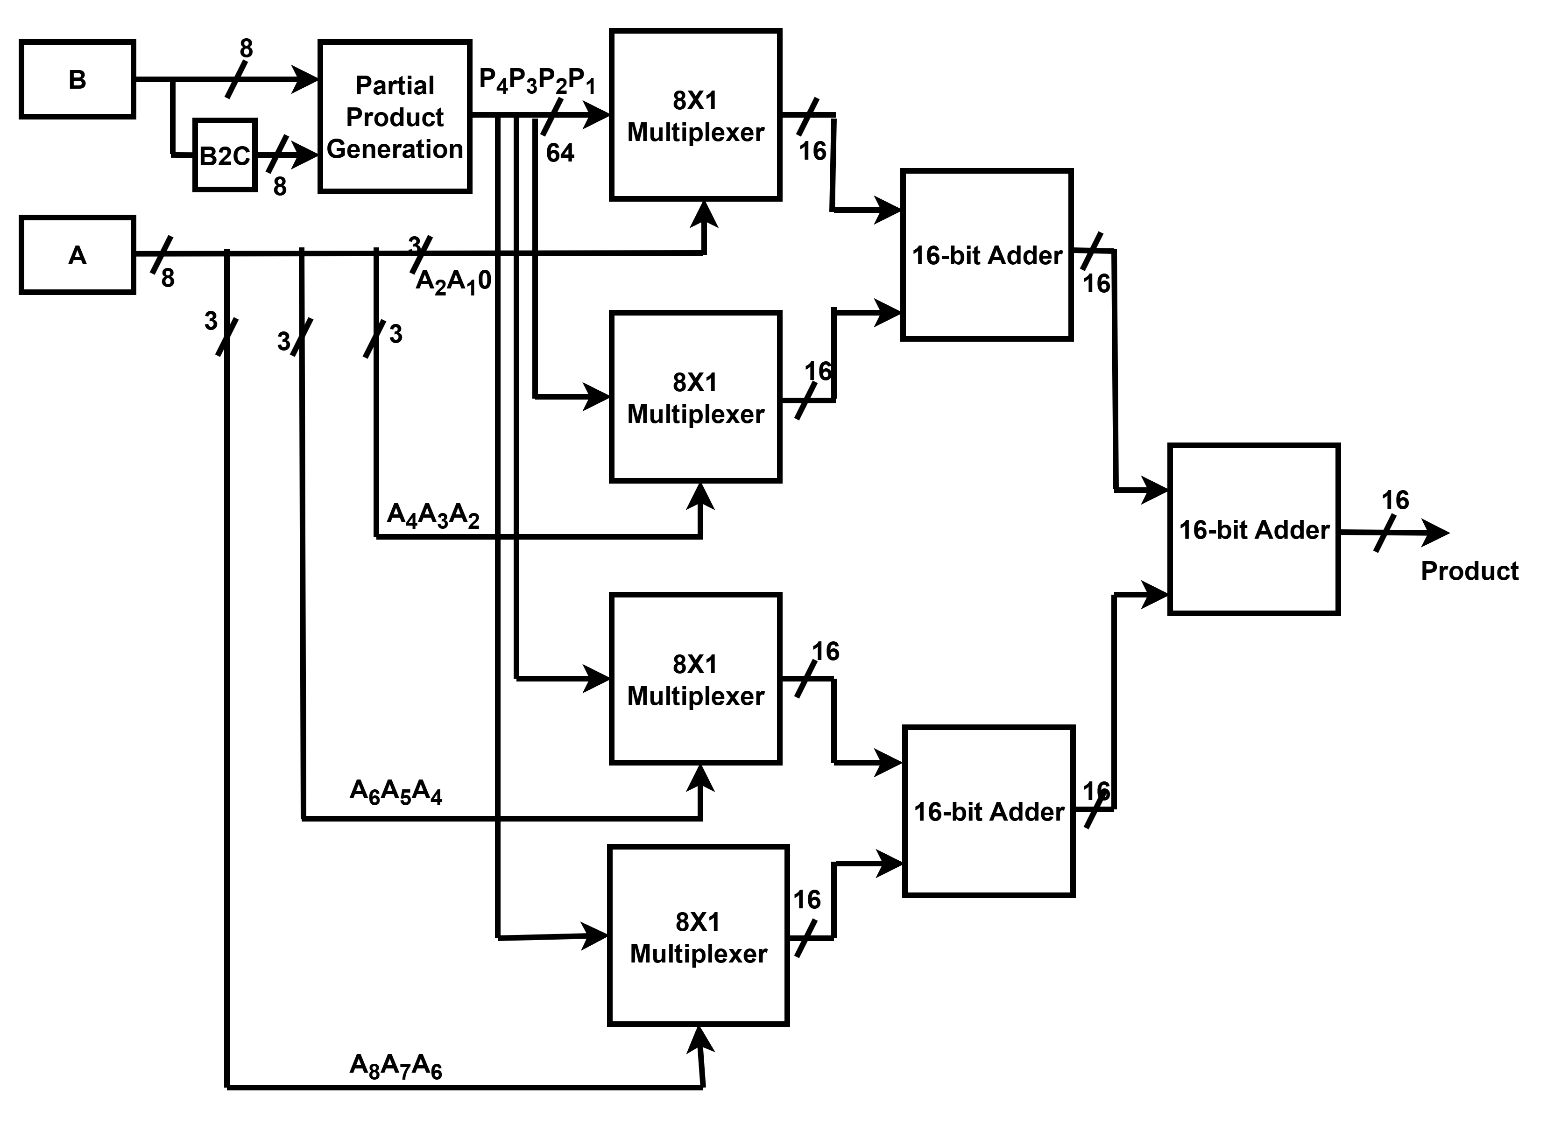
Proposed Booth Multiplier
Centralized PPG for parallel precomputation of partial product
Binary to 2’s complement for creating negative value of B multiplicand
Partial product selection through multiplexer

Slide 12
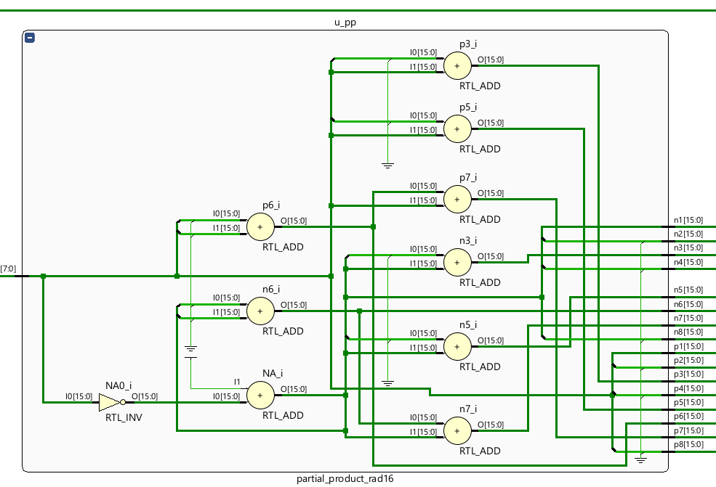
Centralized partial product generation
All partial product (±1A to ±8A for radix 16) generated using RTL adder and shift by bit append method.
Binary to 2's Complement

Slide 13
Comparison of adders
Adder Type | Speed | Area | Power | Complexity | Remarks
Ripple Carry Adder (RCA) | Slow (carry propagates sequentially) | Low | Low | Very Low | Simple, area-efficient; not suitable for high-speed designs
Carry Look-Ahead Adder (CLA) | Fast (parallel carry computation) | Moderate | Moderate | Medium | Good for high-performance; trade-off in area/power
Carry Select Adder (CSLA) | Faster than RCA, slower than CLA | High | Higher | High | Precomputes results for carry-in=0 & 1; uses multiplexers; higher area.

Slide 14
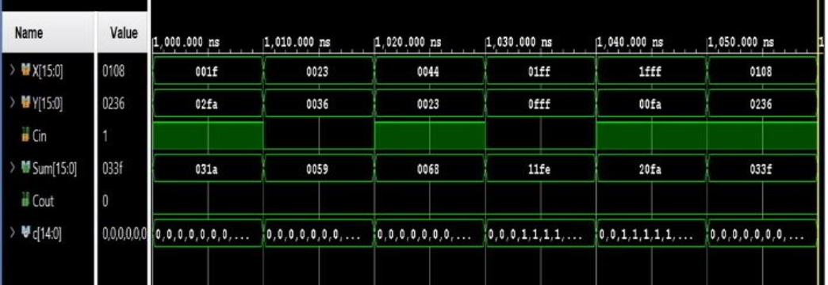
Adder Results of Xilinx Vivado
Parameter | RCA | CLA | CSLA
Delay (ns) | 13.343 | 13.838 | 10.825
Logic power (W) | 0.113 | 0.119 | 0.161
Utilization (LUTs) | 16 | 16 | 23

Slide 15
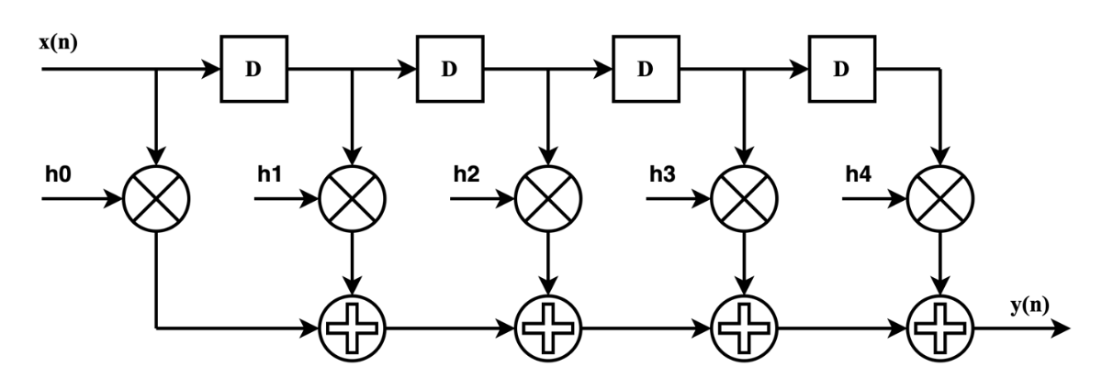
FIR Filter Structure Realizing Direct Form-1
Delay elements store past input samples so each tap multiplies the correct sample with its coefficient.
x(n-1)
x(n-2)
x(n-3)
x(n-4)
Input signal
Output signal
Multiplier coefficient
Multiplier unit
Adder unit

Slide 16
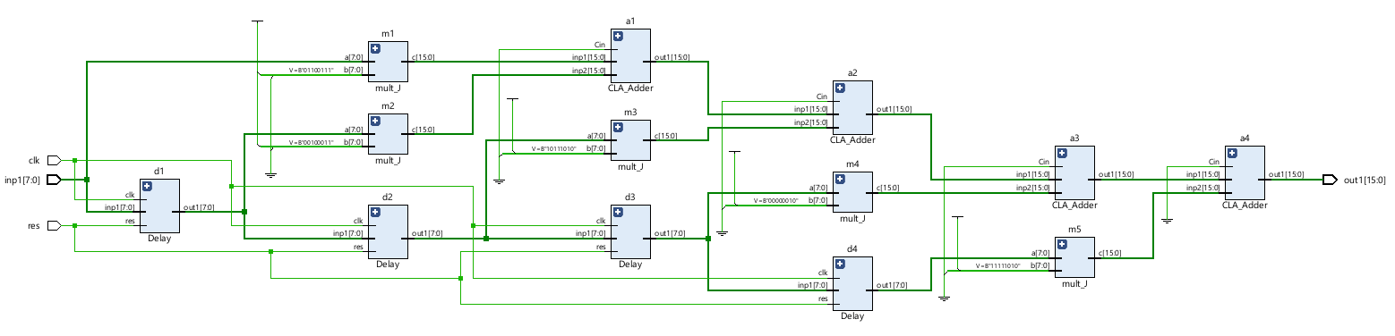
Simulation Result of FIR Filter Structure with RTL Schematic

Slide 17
Implemented performance comparison of FIR filter structure by using radix 4, 8 and 16 multiplier
Parameter | Filter1 | Filter2 | Filter3
Adder | CLA | CLA | CLA
Multiplier | Radix 4 | Radix 8 | Radix 16
Delay (ns) | 22.094 | 24.918 | 27.720
Logic power (W) | 3.266 | 5.255 | 8.847
(LUTs) Utilization | 297 | 1088 | 359

Slide 18
Simulation Methodology
ASIC Verification: Performed using Cadence Genus with a 180 nm standard cell library.
FPGA Comparison: Implemented in Xilinx Vivado 2024.1 Version targeting an Artix-7 evaluation board.
Evaluation Metrics: Area, power, delay, and utilization measured.
Benchmarking: Results compared with previous multiplier designs of three .

Slide 19
Comparison Result of multipliers [4],[5],[6]
Here we have shown the implemented synthesis results of the targeted research paper which is compared with our proposed design.
Parameter | Radix-4^{[4]} | Radix-8^{[5]} | Radix-16^{[6]} | Proposed Design
Delay (ns) | 9.506 | 16.814 | 7.711 | 9.134
Logic power (W) | 1.047 | 1.506 | 1.321 | 0.506
Utilization (LUTs) | 70 | 144 | 253 | 70

Slide 20
Results of Proposed Design Form EDA
8-Bit multiplier Result
Parameter | Radix 4 |  |  | Radix 8 |  |  | Radix 16
 | Conv. design | Proposed | % Imp. | Conv. design | Proposed | % Imp. | Conv. design | Proposed | % Imp.
Area(µm²) | 4877.95 | 4143.27 | 15.06 | 6016.92 | 5143.99 | 14.51 | 7824.46 | 8063.45 | -2.43
Power(µW) | 379.05 | 366.06 | 3.43 | 522.69 | 373.66 | 28.52 | 794.34 | 519.08 | 34.65
Delay(ns) | 10.18 | 8.70 | 14.54 | 10.33 | 9.11 | 11.81 | 13.26 | 10.26 | 22.62
8-bit Gains :Up to 15% area cut, 35% power savings, and 22% faster delay; Radix-16 leads in power/delay.

Slide 21
64-Bit multiplier Result
Parameter | Radix 4 |  |  | Radix 8 |  |  | Radix 16
 | Conv. design | Proposed | % Imp. | Conv. design | Proposed | % Imp. | Conv. design | Proposed | % Imp.
Area(µm²) | 613977.49 | 253175.55 | 58.76 | 405094.28 | 260313.55 | 35.74 | 528143.90 | 359690.7 | 31.89
Power(mW) | 67.57 | 80.85 | -16.43 | 89.84 | 75.16 | 16.34 | 113.86 | 60.76 | 46.64
Delay (ns) | 155.62 | 84.39 | 45.77 | 97.14 | 85.49 | 11.99 | 117.64 | 92.56 | 21.32
64-bit Gains :Up to 59% area savings, 46% delay improvement, and Radix-16 achieves highest power cut (46%).
Key Insight : Radix-4 best for area/delay, Radix-8 balanced, Radix-16 most power-efficient; CPPG scales well for larger designs.

Slide 22
Conclusion
Area & Speed → Radix-4 is best for compact, fast designs.
Balanced → Radix-8 offers a good trade-off between area, speed, and power.
Low Power → Radix-16 suits energy-efficient applications.
Scalable → CPPG improves parallelism and supports high-performance multiplier designs.
For lower bit application such as 8-bit, 16-bit, 24-bit which is used in FIR filter or TWS the radix 4 is better to opt.

Slide 23
Future Work
Using faster adders like Kogge-Stone or Brent-Kung to speed up partial product summation.
Add pipelining to handle higher clock speeds.
Try low-power approximate adders for energy-efficient designs.
Improve encoding and conversion for higher-radix multipliers.
Extend the design to multi-operand multipliers and larger FIR filters for better PPA.

Slide 24
References
David Money Harris, Sarah Harris, "Digital Design and Computer Architecture", Morgan Kaufmann publishers
Kundeti Nagarjuna, R. Krishna, "Efficient Implementation of High-Speed Low Power Digital Fir Filter Architecture Design by Radix-4 Multiplier", International Journal of Science, Engineering and Technology
Naga Venkata Vijaya Krishna Boppana, Jeevani Kommareddy, Saiyu Ren, “Low-cost and High-performance 8×8 Booth Multiplier “, Circuits, Systems, and Signal Processing (2019) 38:4357–4368
Ahsan Rafiq, Maksim Jenihhin, "An optimized design of delay-and energy-efficient Booth multiplier" in e-Prime - Advances in Electrical Engineering, Electronics and Energy 9 (2024) 100698, ELSEVIER
Boppana, N.V.V.K., Ren, S.: Simple low power-delay-product parallel signed multiplier design using radix-8 structure with efficient partial product reduction. J. Eng. 2023, e12296 (2023). https://doi.org/10.1049/tje2.12296
Serap Ceklia, *, Ali Akmanb,” A high speed pipelined radix-16 Booth multiplier architecture for FPGA implementation” AEUE - International Journal of Electronics and Communications 185 (2024) 155435
Lad Ketan Khandubhai, "A High-Performance FIR filter using Logarithmic Number System”.
Kher Divya, "Comparatively Analysis of Approximate Multiplier for Signal Processing Application”
Gandhi Dhavalkumar Rameshchandra, "Low Power High Performance Multiplier”
References for TWS
https://www.qualcomm.com/products/features/truewireless
https://www.silergy.com/use/True+Wireless+Stereo+%28TWS%29
https://www.embedded.com/case-study-optimizing-ppa-with-risc-v-custom-extensions-in-tws-earbuds/

Slide 25

Questions & Comments

